Slide 1
Stack Overflow
Programmer’s social life

Slide 2
StackOverflow – Programmer’s social network
Stack Overflow is a question and answer site for programmers
It started from 2008
More than 10m registered users, more than 16m questions.

Slide 3
Exploring Programmer’s Social Life
What are we exploring
What’s the different behavior between programmer and users in other social network
What affects programmers’ social behavior
Demonstrate the detail
Users analysis by geometry
Age distribution
Contribution to open source
How many answers have up votes and down votes
Top 20 users' ranking by yearly growth
Top 10 popular categories by year and users number participation.
Posts without answers
Draw a conclusion
Programmers also have social life.
Programmers like different thing.
Programmer have their favorite and disagree.
Programmers like to be recognized
Programmer follow trend also
Programmer got disappear some times
Notes:
Through the data, we can see Stackoverflow is a special social networking tool. Programmer like to be recognizedMany programmers participate and contribute.
Programmers also follow hot topics.
Programmers have their favorite and disagreement in different place.
Programmers like technology, technology affect their behaviors
Some programmers really like to share.

Slide 4
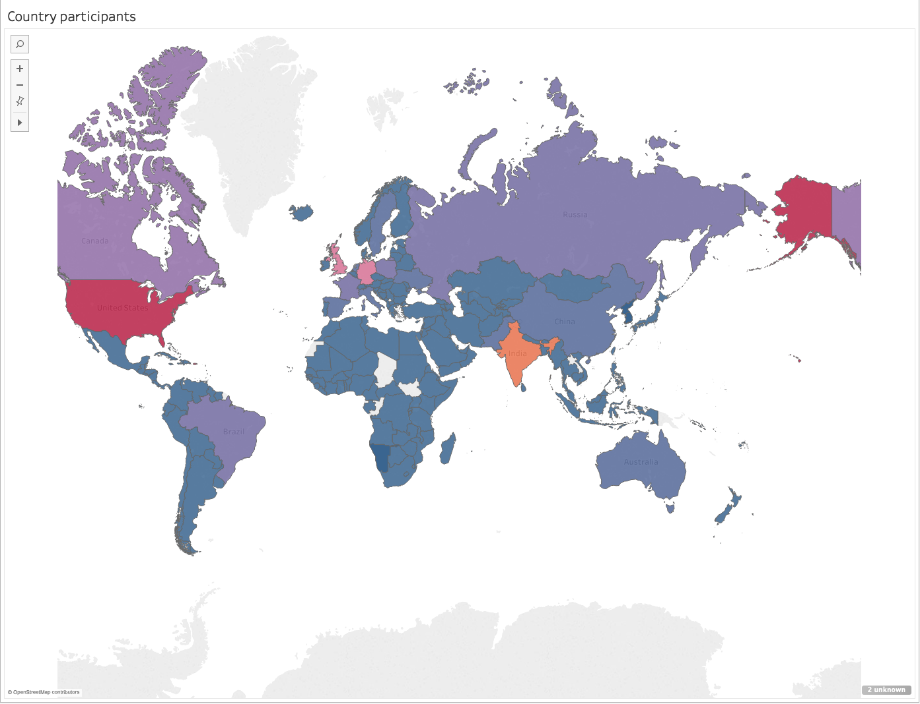
Users by geometry

Slide 5
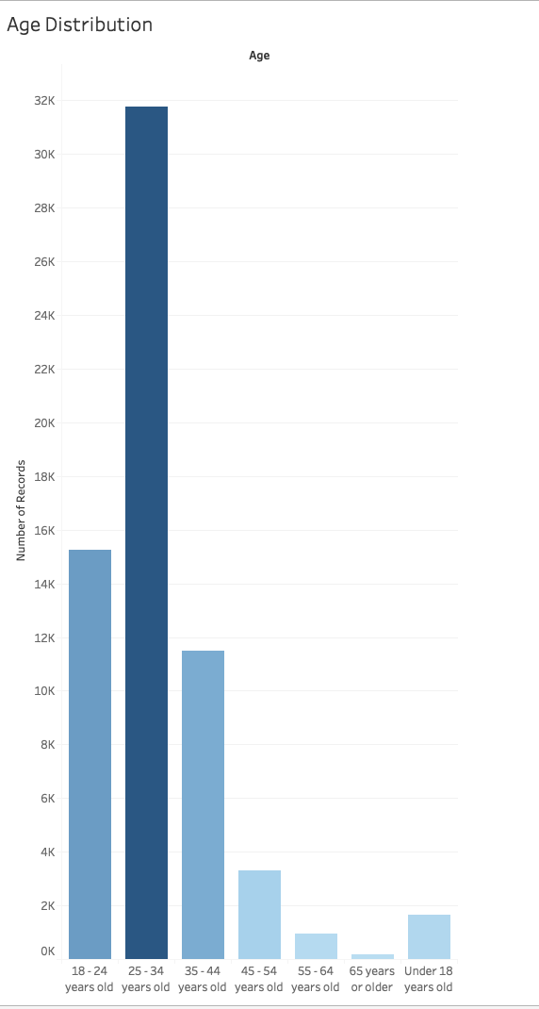

Slide 6
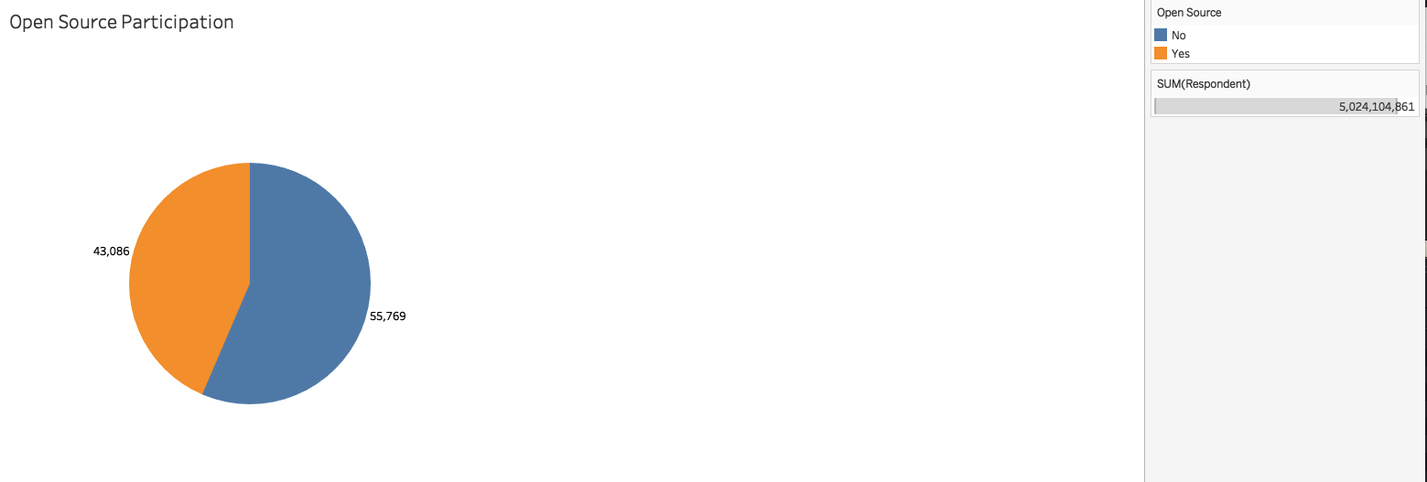

Slide 7
